Slide 1

6th Grade Accelerated Math
Unit 5, Lesson 9 Applying Ratios to Solve Problems Involving Percentages Volume 1, pg. 214

Slide 2


Benchmark
MA.6.AR.3.4
Apply ratio relationships to solve mathematical and real-world problems involving percentages using the relationship between two quantities.
volume 1, pg. 214

Slide 3
Integrated Mathematical Thinking and Reasoning Standards
MA.K12.MTR.2.1 Demonstrate understanding by representing problems in multiple ways.
MA.K12.MTR.7.1 Apply mathematics to real-world contexts.
volume 1, pg. 214

Slide 4

Learning Target
I can apply ratio relationships to solve problems involving percentages.
volume 1, pg. 214

Slide 5

Warm-Up
volume 1, pg. 214

Slide 6
5.9.1 Warm-Up: Percentages on the Number Line
Place a digit in each blue box to create an accurate number line. Use only digits 0 to 9, at most one time each. The number line is not drawn to scale.
0
0%
%
100%
volume 1, pg. 214

Slide 7

Guided Practice
volume 1, pg. 215

Slide 8

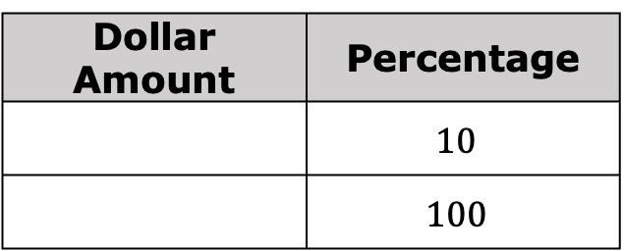
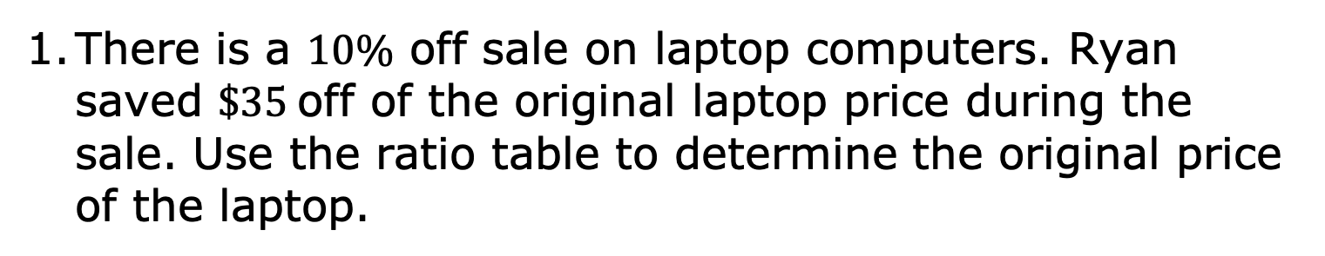
5.9.2 Guided Practice: Applying Ratio Relationships to Solve Percentage Problems
There is a $10\%$ off sale on laptop computers. Ryan saved $\$35$off of the original laptop price during the sale. Use the ratio table to determine the original price of the laptop.
Dollar Amount | Percentage
 | $10$
 | $100$
volume 1, pg. 215

Slide 9
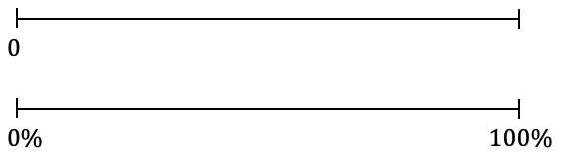
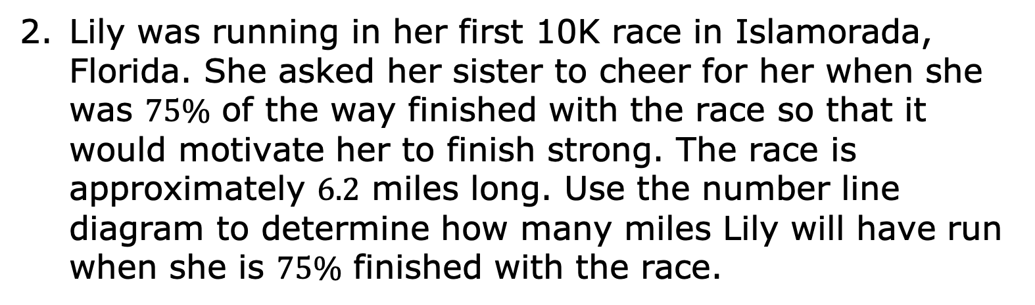
Lily was running in her first 10K race in Islamorada, Florida. She asked her sister to cheer for her when she was $75\%$ of the way finished with the race so that it would motivate her to finish strong. The race is approximately $6.2$ miles long. Use the number line diagram to determine how many miles Lily will have run when she is $75\%$ finished with the race.
volume 1, pg. 215

Slide 10
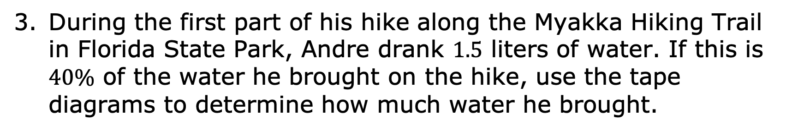
During the first part of his hike along the Myakka Hiking Trail in Florida State Park, Andre drank $1.5$ liters of water. If this is $40\%$ of the water he brought on the hike, use the tape diagrams to determine how much water he brought.
water (liters)
percentage
Andre brought _____ liters of water with him on the hike.
volume 1, pg. 215

Slide 11

Exploration
volume 1, pg. 216

Slide 12

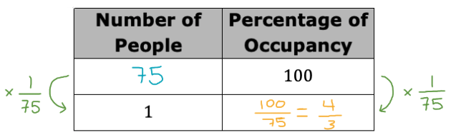
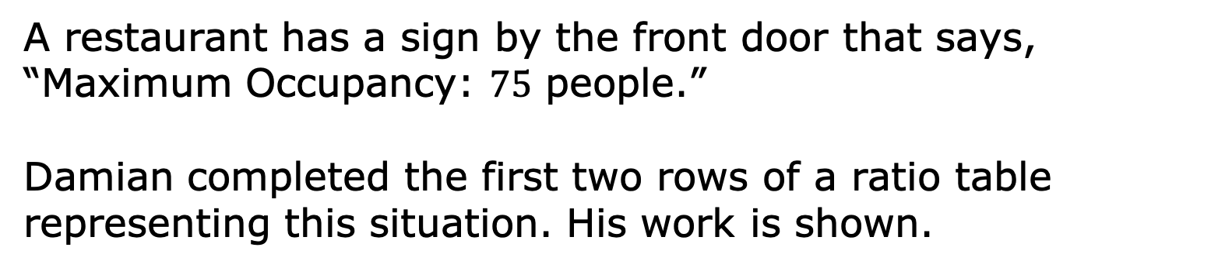
5.9.3 Exploration: Using Tables and Unit Rates with Percentages
A restaurant has a sign by the front door that says, “Maximum Occupancy: $75$ people.”
Damian completed the first two rows of a ratio table representing this situation. His work is shown.
volume 1, pg. 216

Slide 13
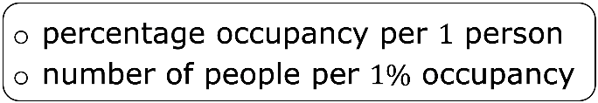
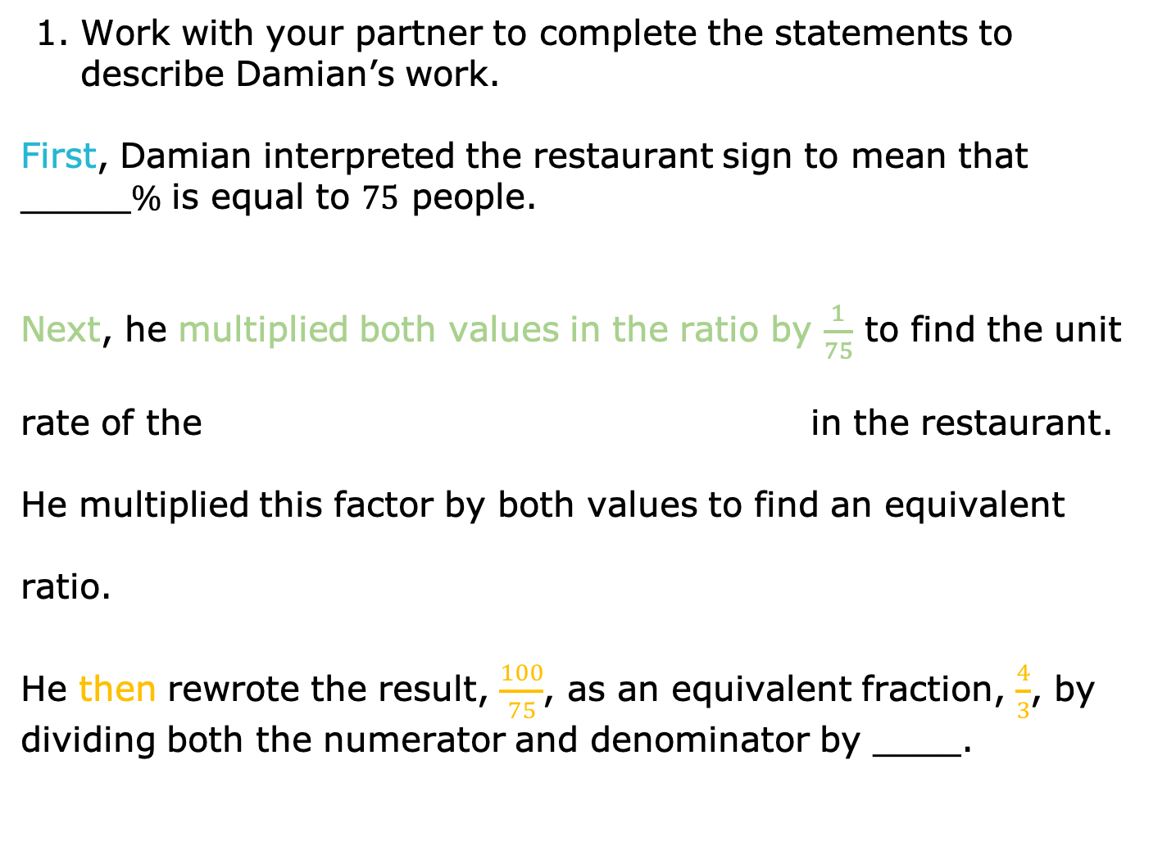
Work with your partner to complete the statements to describe Damian’s work.
First, Damian interpreted the restaurant sign to mean that _____$\%$ is equal to $75$ people.
Next, he multiplied both values in the ratio by $\frac{1}{75}$ to find the unit rate of the in the restaurant. He multiplied this factor by both values to find an equivalent ratio.
He then rewrote the result, $\frac{100}{75}$, as an equivalent fraction, $\frac{4}{3}$, by dividing both the numerator and denominator by ____.
volume 1, pg. 216

Slide 14
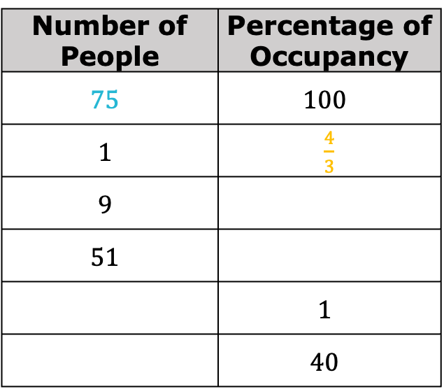
With your partner, complete the table to find additional equivalent ratios. Use arrows and multiplication to show how you determine the values in each row.
Number of People | Percentage of Occupancy
$$75$$ | $$100$$
$$1$$ | $\frac{4}{3}$
$$9$$
$$51$$
 | $$1$$
 | $$40$$
volume 1, pg. 216

Slide 15
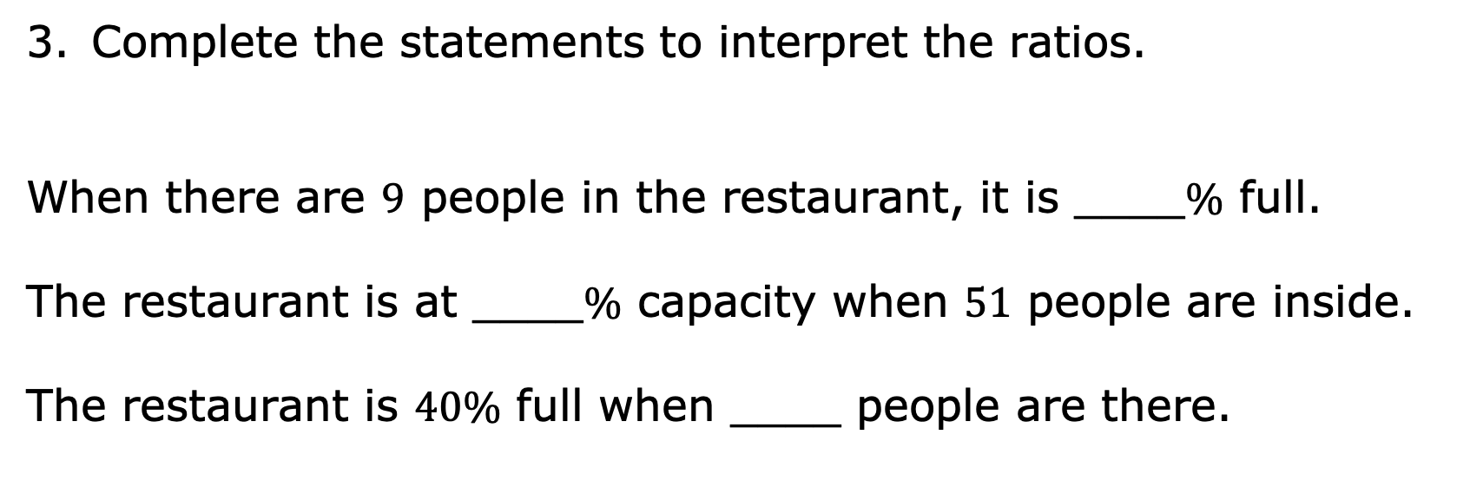
Complete the statements to interpret the ratios.
When there are $9$ people in the restaurant, it is ____$\%$ full.
The restaurant is at ____$\%$ capacity when $51$ people are inside.
The restaurant is $40\%$ full when ____ people are there.
volume 1, pg. 216

Slide 16
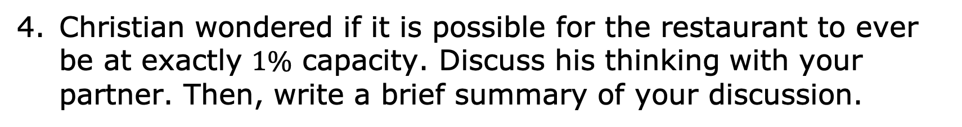
Christian wondered if it is possible for the restaurant to ever be at exactly $1\%$ capacity. Discuss his thinking with your partner. Then, write a brief summary of your discussion.
volume 1, pg. 217

Slide 17
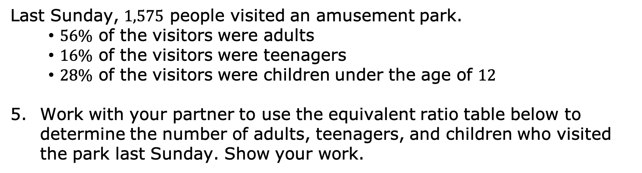
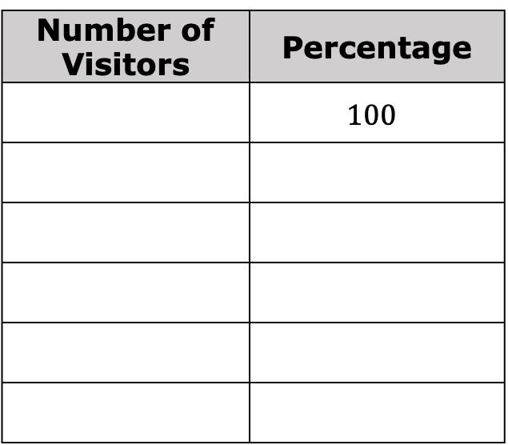
Last Sunday, $1,575$ people visited an amusement park.
$56\%$ of the visitors were adults
$16\%$ of the visitors were teenagers
$28\%$ of the visitors were children under the age of $12$
Work with your partner to use the equivalent ratio table below to determine the number of adults, teenagers, and children who visited the park last Sunday. Show your work.
Number of Visitors | Percentage
 | $$100$$
volume 1, pg. 217

Slide 18
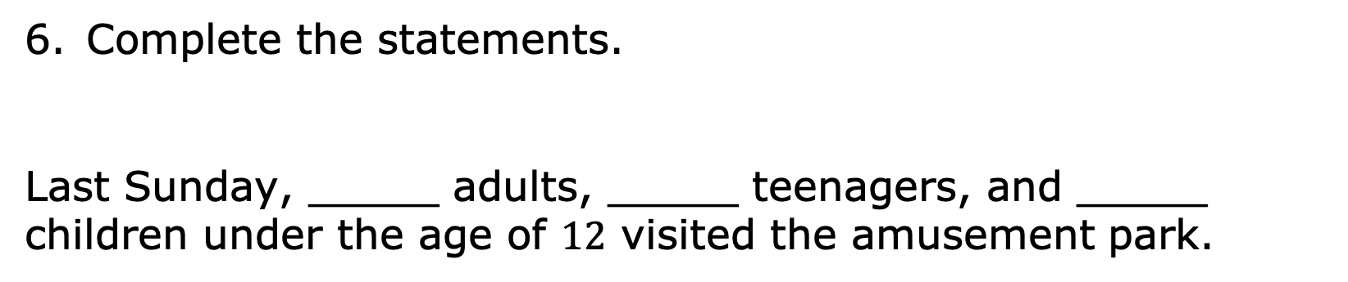
Complete the statements.
Last Sunday, _____ adults, _____ teenagers, and _____ children under the age of $12$ visited the amusement park.
volume 1, pg. 217

Slide 19

Your Turn
volume 1, pg. 217

Slide 20
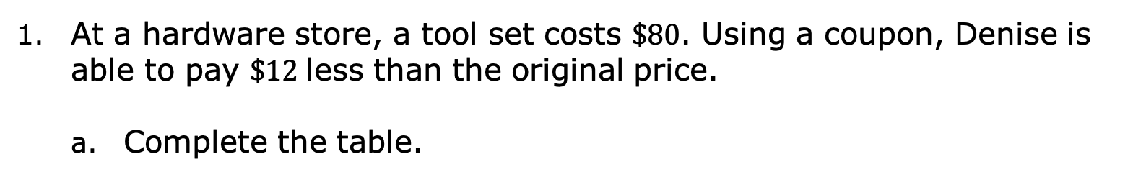
5.9.4 Your Turn!
At a hardware store, a tool set costs $\$80$. Using a coupon, Denise is able to pay $\$12$less than the original price.
Complete the table.
Dollar Amount | Percentage
The coupon gives Denise _____$\%$ off of the original price.
volume 1, pg. 217

Slide 21
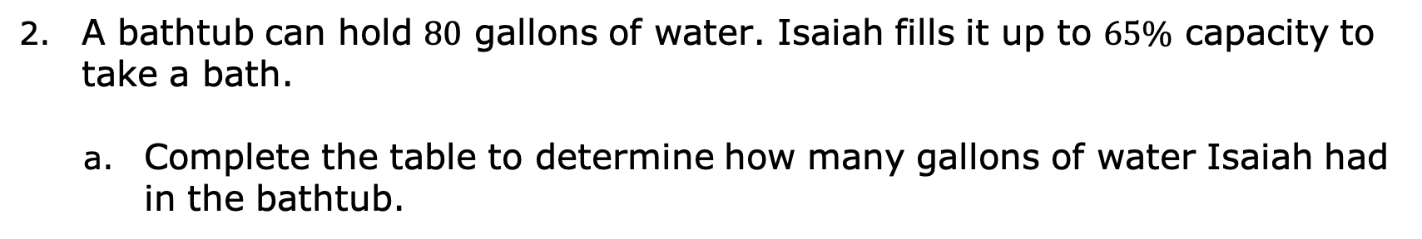
A bathtub can hold $80$ gallons of water. Isaiah fills it up to $65\%$ capacity to take a bath.
Complete the table to determine how many gallons of water Isaiah had in the bathtub.
Number of Gallons | Percentage of Capacity
Isaiah filled the tub with _____ gallons of water to be at $65\%$ capacity.
volume 1, pg. 218

Slide 22

Wrap-Up
volume 1, pg. 218

Slide 23
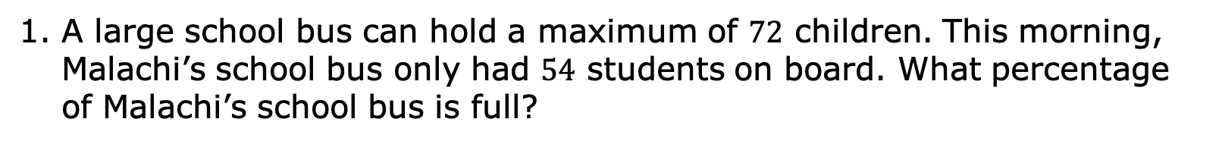
5.9.5 Wrap-Up: Ticket Out the Door
A large school bus can hold a maximum of $72$ children. This morning, Malachi’s school bus only had $54$ students on board. What percentage of Malachi’s school bus is full?
Number of Students | Percentage of Capacity
volume 1, pg. 218

